Slide 1
L7.1 Autonomous Driving with Imitation &Reinforcement Learning
Zonghua Gu, Umeå University
Nov. 2023
Acknowledgement: slides based on https://www.coursera.org/specializations/reinforcement-learning
And textbook by Sutton and Barto http://incompleteideas.net/book/the-book-2nd.html

Slide 2
Outline
Introduction to IL and IRL
Paper discussions

Slide 3
RL Reward Function Issues
RL can be very effective, provided that a suitable reward function is available.
Bad reward function leads to undesirable behavior
Suppose you design a vacuum cleaner to maximize reward function defined as “cumulative amount of dirt sucked in”. The vacuum cleaner may learn to repeatedly spit out and suck in the same pile of dirt!
For AD in realistic environment, the goal is to reach destination with minimum time, while avoiding accidents. But how to encode this into a reward function?
“A great reward function can help you better optimize your reinforcement learning model. In AWS DeepRacer, the reward function is written in Python code, and uses different input parameters to help encourage good behavior and disincentivize poor behavior. There’s no single right answer for which parameters to include in your reward function, and your best reward function will likely require a lot of experimentation.” from AWS DeepRacer MOOC

Slide 4
Imitation Learning (IL)
IL is useful when it is easier for an expert to demonstrate the desired behavior, rather than to specify a reward function for RL to learn the policy.
e.g., for Automated Driving in a realistic environment, the reward function would be a huge complex function involving everything in the environment
Requires access to an expert, either offline (driving data logs) or online (query-on-demand)
Also called Learning from Demonstrations.
IL variants:
Learn to mimic the expert’s policy
Behavior Cloning
Direct Policy Learning
Learn the expert’s value function
Inverse Reinforced Learning

Slide 5
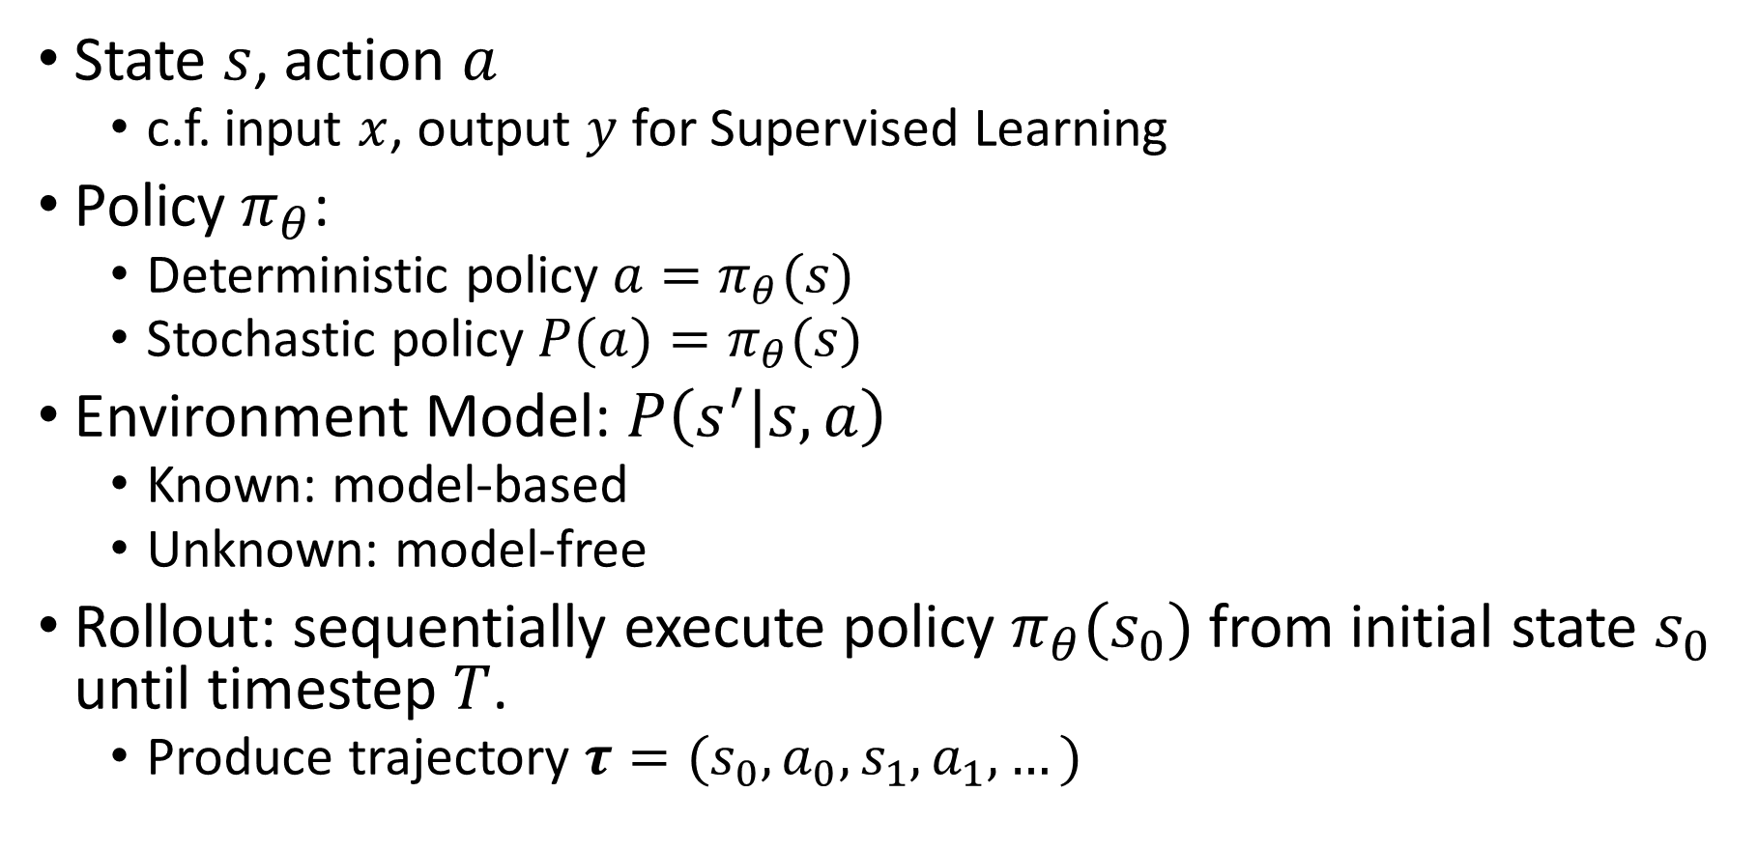
Review: Notations
State $s$, action $a$
c.f. input $x$, output $y$ for Supervised Learning
Policy $π_{θ}$:
Deterministic policy $a=π_{θ}(s)$
Stochastic policy $P(a)=π_{θ}(s)$
Environment Model: $P\left(s^{′} | s,a\right)$
Known: model-based
Unknown: model-free
Rollout: sequentially execute policy $π_{θ}(s_{0})$ from initial state $s_{0}$ until timestep $T$.
Produce trajectory $τ=(s_{0},a_{0},s_{1},a_{1},…)$

Slide 6
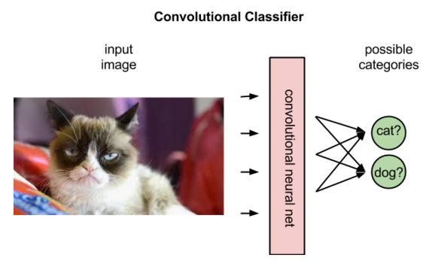
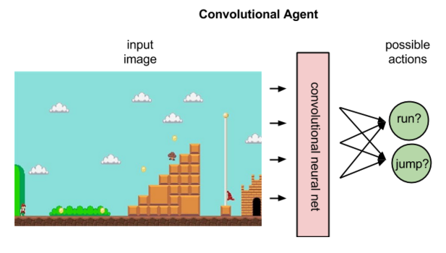
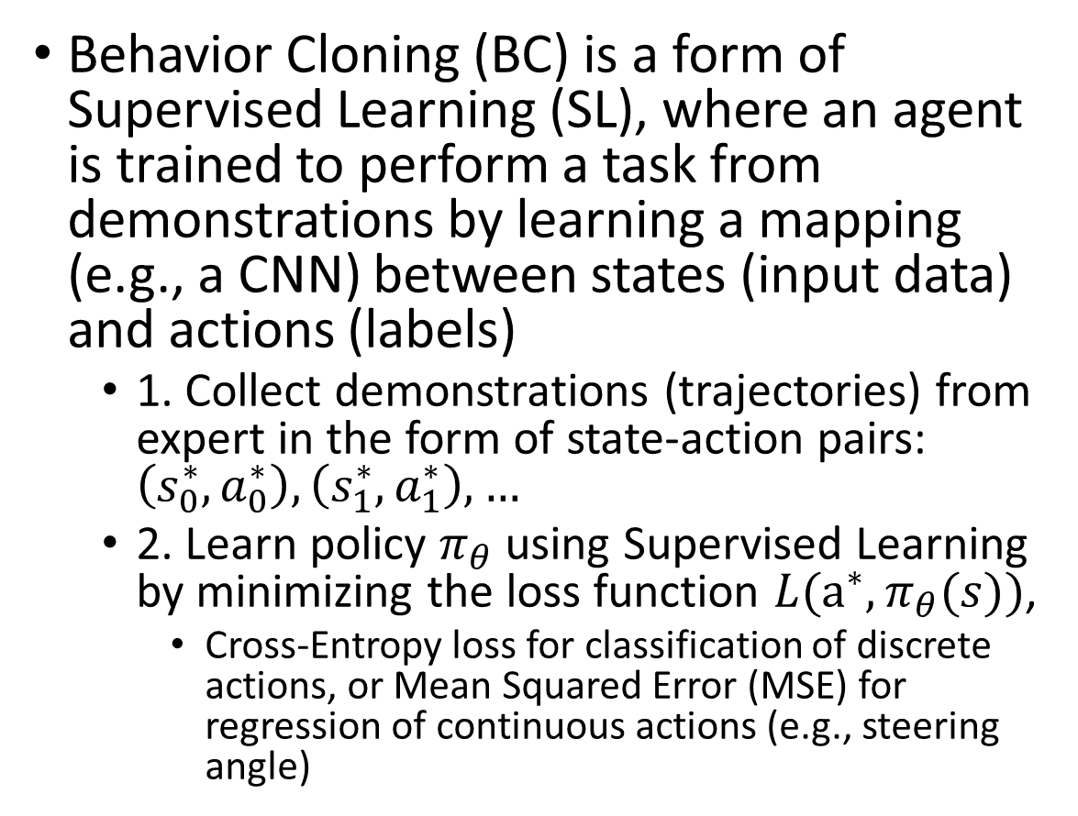
Behavior Cloning (BC)
Behavior Cloning (BC) is a form of Supervised Learning (SL), where an agent is trained to perform a task from demonstrations by learning a mapping (e.g., a CNN) between states (input data) and actions (labels)
1. Collect demonstrations (trajectories) from expert in the form of state-action pairs: $\left(s_{0}^{∗},a_{0}^{∗}\right),\left(s_{1}^{∗},a_{1}^{∗}\right),…$
2. Learn policy $π_{θ}$ using Supervised Learning by minimizing the loss function $L(a^{∗},π_{θ}(s))$,
Cross-Entropy loss for classification of discrete actions, or Mean Squared Error (MSE) for regression of continuous actions (e.g., steering angle)
https://pathmind.com/wiki/deep-reinforcement-learning

Slide 7
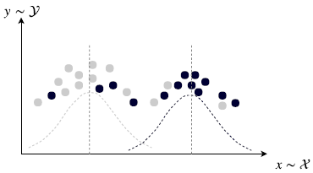
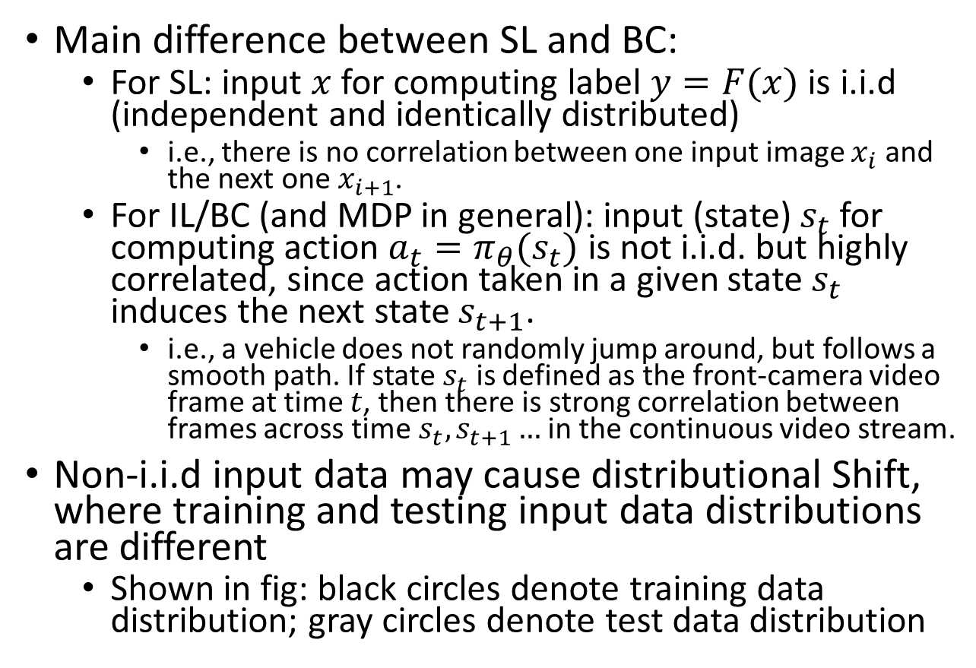
Supervised Learning (SL) vs. Behavior Cloning (BC)
Main difference between SL and BC:
For SL: input $x$ for computing label $y=F(x)$ is i.i.d (independent and identically distributed)
i.e., there is no correlation between one input image $x_{i}$ and the next one $x_{i+1}$.
For IL/BC (and MDP in general): input (state) $s_{t}$ for computing action $a_{t}=π_{θ}(s_{t})$ is not i.i.d. but highly correlated, since action taken in a given state $s_{t}$ induces the next state $s_{t+1}$.
i.e., a vehicle does not randomly jump around, but follows a smooth path. If state $s_{t}$ is defined as the front-camera video frame at time $t$, then there is strong correlation between frames across time$s_{t},s_{t+1}…$ in the continuous video stream.
Non-i.i.d input data may cause distributional Shift, where training and testing input data distributions are different
Shown in fig: black circles denote training data distribution; gray circles denote test data distribution
Notes:
https://pathmind.com/wiki/deep-reinforcement-learning

Slide 8
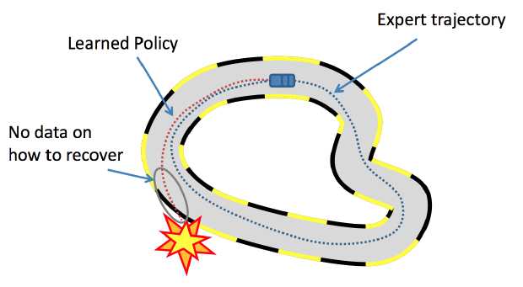
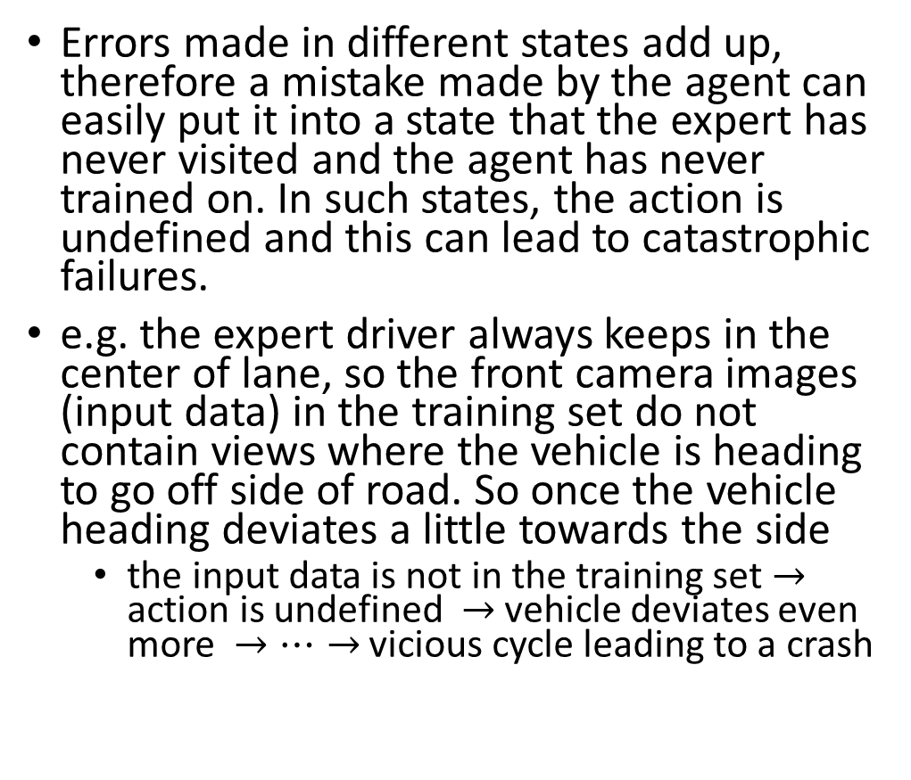
Distributional Shift in IL/BC
Errors made in different states add up, therefore a mistake made by the agent can easily put it into a state that the expert has never visited and the agent has never trained on. In such states, the action is undefined and this can lead to catastrophic failures.
e.g. the expert driver always keeps in the center of lane, so the front camera images (input data) in the training set do not contain views where the vehicle is heading to go off side of road. So once the vehicle heading deviates a little towards the side
the input data is not in the training set $→$ action is undefined $→$ vehicle deviates even more $→…→$ vicious cycle leading to a crash
https://medium.com/@SmartLabAI/a-brief-overview-of-imitation-learning-8a8a75c44a9c

Slide 9
Inverse Reinforcement Learning (IRL)
Start with a set of expert’s demonstrations (assumed to be optimal), estimate the parameterized reward function that would cause the expert’s behavior/policy.
Problem: reward function is not unique, multiple reward functions may lead to the same behavior.
e.g., an outside observer sees that you work very hard (behavior). He may infer your reward function to be “maximize WorkTime” (since you really enjoy your job). But your actual reward function is “maximize MoneyEarned” (while you really hate your job).
An agent with incorrect reward function won’t generalize well in a different environment.
e.g., suppose someone trains an agent to imitate you. The agent has the same behavior as you in the current environment, but faced with a job offer with higher salary, the agent may take a different action than you.
Solution: try to learn the correct reward function by observing the expert in diverse environments.

Slide 10
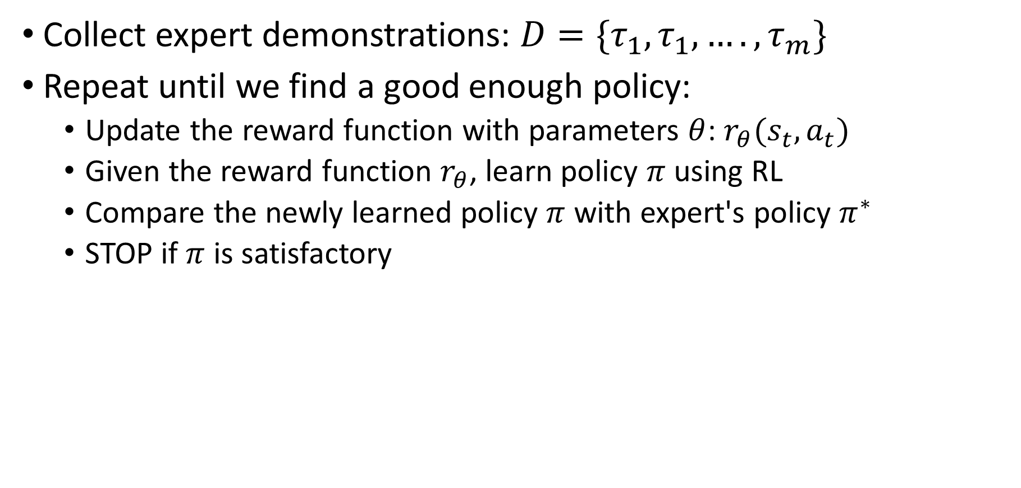
IRL Procedure
Collect expert demonstrations: $D=\{τ_{1},τ_{1},….,τ_{m}\}$
Repeat until we find a good enough policy:
Update the reward function with parameters $θ$: $r_{θ}(s_{t},a_{t})$
Given the reward function $r_{θ}$, learn policy $π$ using RL
Compare the newly learned policy $π$ with expert's policy $π^{∗}$
STOP if $π$ is satisfactory
Notes:
Repeat until we find a good enough policy:
Update the reward function parameters
Solve the RL problem to find the optimal policy
Compare the newly learned policy with the expert’s policy

Slide 11
PilotNet [Bojarski 2016]
Bojarski M, Del Testa D, Dworakowski D, et al. End to end learning for self-driving cars[J]. arXiv preprint arXiv:1604.07316, 2016.

Slide 12
Projects of IL (BC) Applied to AD
ALVINN
CMU, 1990
Front-camera low-res image as input
Multi-Layer Perceptron (MLP) (Fully-Connected NN)
DAVE
Muller, LeCun, 2003
Front-camera low-res image as input
CNN
PilotNet
Bojarski et al. 2016
Front-camera high-res image as input
CNN

Slide 13
Training Method
End-to-End model trained with Imitation Learning (BC)
Human drives vehicle
Record sensor data and human actuator commands as training pairs
Train a DNN to map sensor data to actuator commands, mimicking a human. (PilotNet controls steering only. I think acceleration/braking are controlled separately, but the paper did not say how.)
PilotNet driving video:
https://www.youtube.com/watch?v=_N7nC-8YxzE
https://github.com/lhzlhz/PilotNet

Slide 14
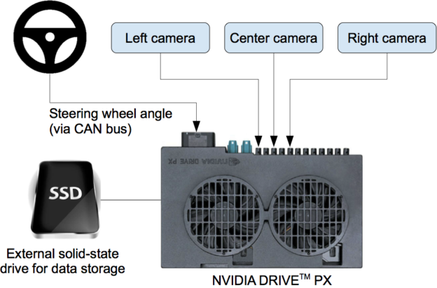
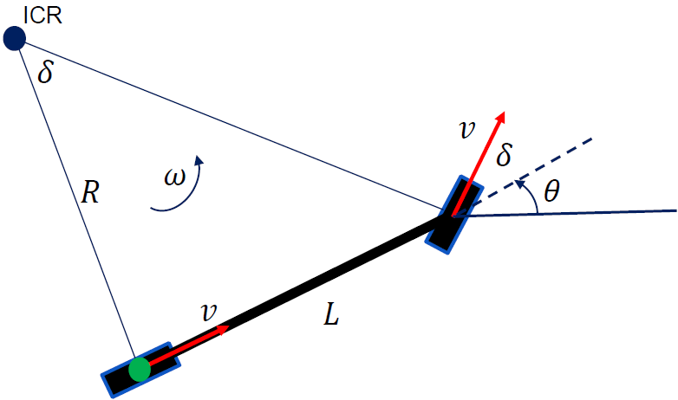
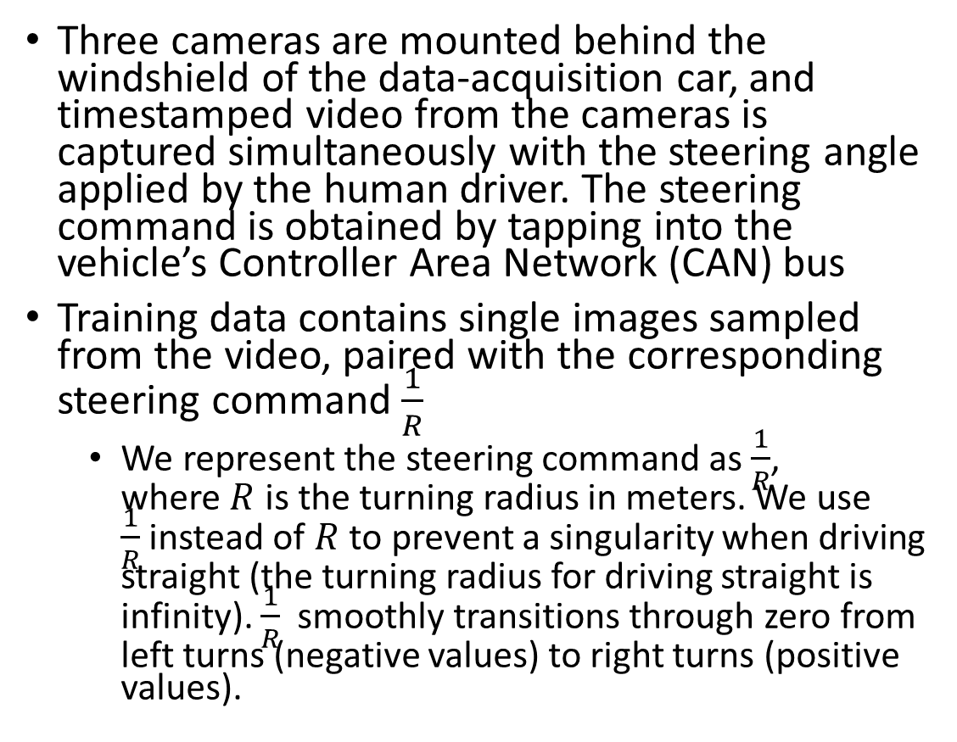


Data Collection System
Three cameras are mounted behind the windshield of the data-acquisition car, and timestamped video from the cameras is captured simultaneously with the steering angle applied by the human driver. The steering command is obtained by tapping into the vehicle’s Controller Area Network (CAN) bus
Training data contains single images sampled from the video, paired with the corresponding steering command $\frac{1}{R}$
We represent the steering command as $\frac{1}{R}$, where $R$ is the turning radius in meters. We use $\frac{1}{R}$instead of $R$ to prevent a singularity when driving straight (the turning radius for driving straight is infinity). $\frac{1}{R}$ smoothly transitions through zero from left turns (negative values) to right turns (positive values).
https://devblogs.nvidia.com/deep-learning-self-driving-cars/
$$\frac{1}{R}=\frac{\tan{δ}}{L}$$
$$θ$$

Slide 15
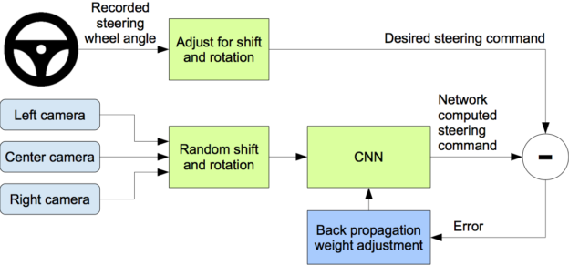
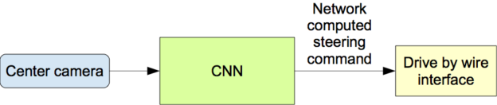
Training Data Augmentation
Problem: training data from human driver always stays in center of lane. So if car deviates from center, the image it sees is not in the training set, so it does not know the correct action.
Solution: Augment training data with additional images that show the car in different shifts from the center of the lane and rotations from the direction of the road. The images for two specific off-center shifts can be obtained from the left and the right cameras.
Training
Testing

Slide 16
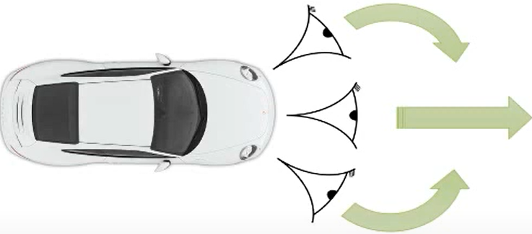
Training Data Augmentation Details
We augment the data by adding artificial shifts and rotations to teach the network how to recover from a poor position or orientation
Images for two specific off-center shifts can be obtained from the left and right cameras
Image from center camera shows car is driving straight; Shifted image from left camera shows car is leaning left. Associate this image with synthetic “turn right” command (even though human driver never issued it). During operation, if the center camera sees this image, issue “turn right” command
Additional shifts between the cameras and all rotations are simulated by viewpoint transformation of the image from the nearest camera. The steering label for transformed images is adjusted to one that would steer the vehicle back to the desired location and orientation in two seconds

Slide 17
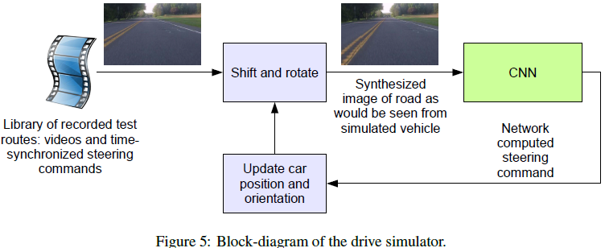
Driving Simulator
The simulator transforms the original images to account for departures from the ground truth. The magnitude of these perturbations is chosen randomly from a normal distribution.
17

Slide 18
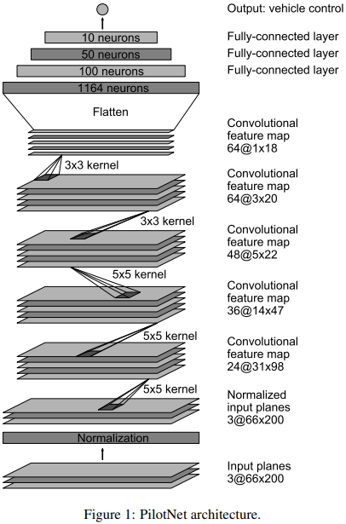
PilotNet CNN Architecture
The network consists of 9 layers, including a normalization layer, 5 convolutional layers and 3 fully connected layers. The input image is split into YUV planes and passed to the network. The first layer of the network performs image normalization
Strided convolutions are used in the first three convolutional layers with a 2×2 stride and a 5×5 kernel and a non-strided convolution with a 3×3 kernel size in the last two convolutional layers.
The five convolutional layers are followed with three fully connected layers leading to an output control value that is the inverse turning radius

Slide 19
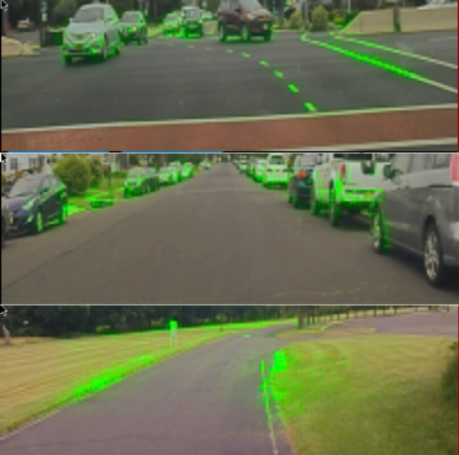
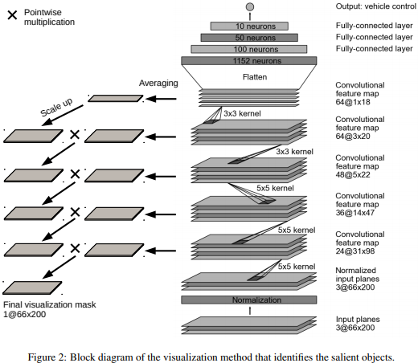
Visualization of Salient Objects
The visualization shows which regions of the input image contribute most to the output of the network. These regions identify the salient objects (highlighted in green).
PilotNet focuses on the same things a human driver would, including lane markers, road edges and other cars.
Bojarski M, Yeres P, Choromanska A, et al. Explaining how a deep neural network trained with end-to-end learning steers a car[J]. arXiv preprint arXiv:1704.07911, 2017.

Slide 20
On-Road Tests
After a trained network has demonstrated good performance in the simulator, the network is loaded on NVIDIA DRIVE PX in our test car and taken out for a road test
For a typical drive in Monmouth County NJ from our office in Holmdel to Atlantic Highlands, we are autonomous approximately 98% of the time. We also drove 10 miles on the Garden State Parkway (a multi-lane divided highway with on and off ramps) with zero intercepts

